Slide 1
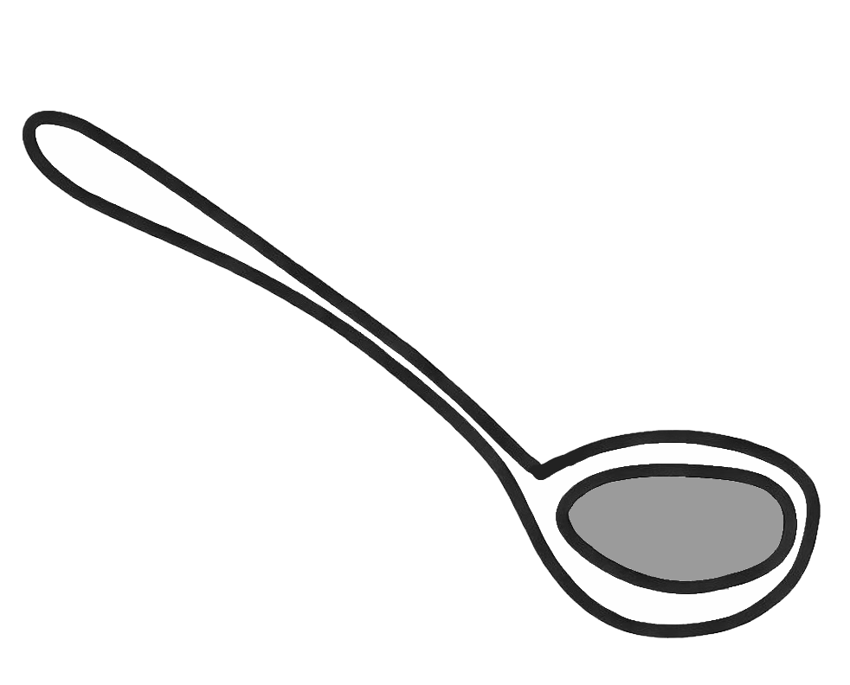
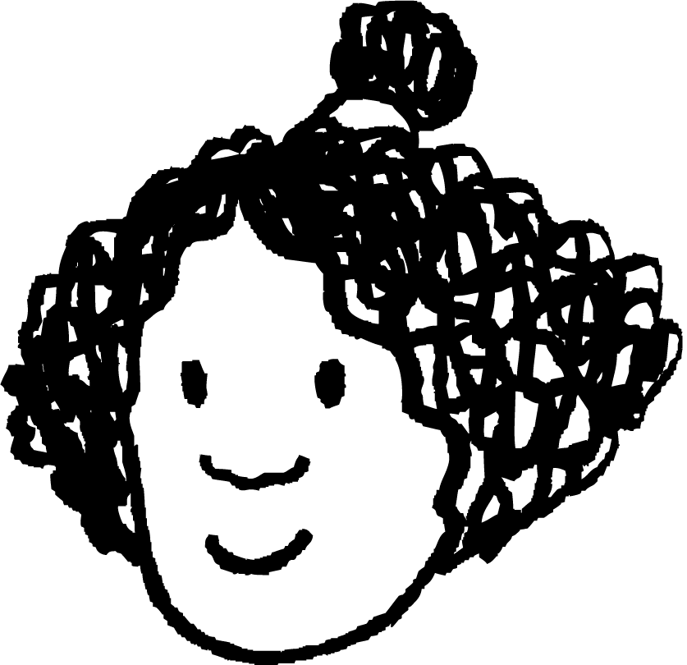
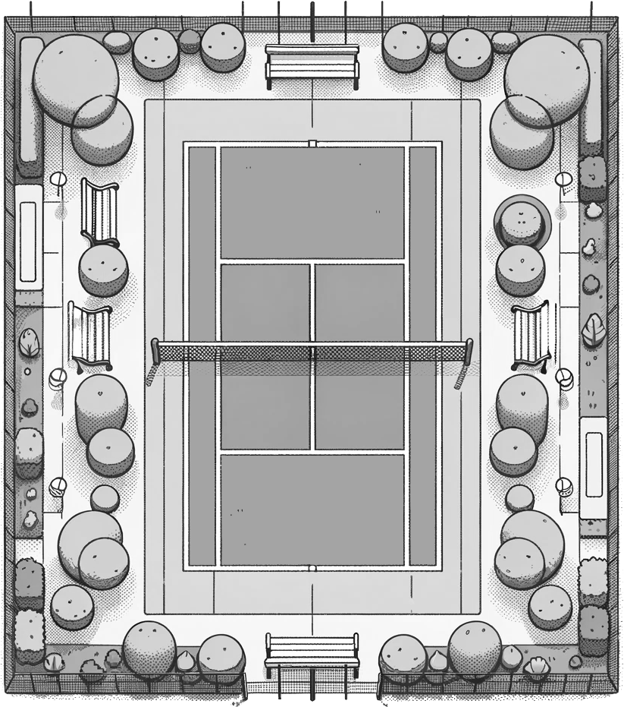


Pythagoras’ theorem in context
Task A: Contexts modelled by right-angled triangles
1) For this ladle to be usable with the saucepan, it has to be long enough that it won’t sink completely into the saucepan.
The saucepan is 20 cm tall and has a maximum base width of 30 cm.
a) The right-angled triangle models the saucepan. Label the saucepan and the right-angled triangle with the appropriate lengths.
b) Using Pythagoras’ theorem, explain whether the ladle is long enough to be used with this saucepan.
saucepan
ladle
35 cm
Izzy
2) Izzy is practicing her backhand shots. She can hit a backhand shot 28 metres.
Sofia and Laura stand at different corners of the court.
24 m
a) Model this context onto this right-angled triangle, labelling any relevant distances given in the context.
11 m
b) Explain whether Izzy’s backhand shot can reach Sofia.
Sofia
Laura
c) Using Pythagoras’ theorem, explain whether Izzy’s backhand shot can reach Laura.

Slide 2

Pythagoras’ theorem in context
3) A train conductor uses a 256 cm long access ramp to help passengers board a maglev train.
The step to board the train is 43 cm higher than the platform the passengers are waiting on.
How far onto the platform will the access ramp reach (to 1 d.p.)?
train
256 cm
43 cm
access ramp
252.4 cm
The minimum horizontal distance away from the train is 252.4 cm.
platform
train
252.4 cm
Task B: Analysing and evaluating modelled contexts
1) Radio towers must be at most 3000 m apart from each other in order for the radio signal to be broadcast to the local area.
Radio tower B is 1900 m north of radio tower A.
And radio tower C is 2400 m west of radio tower A.
a) Model the distances between all three radio towers on this right-angled triangle, labelling each vertex A, B, or C to represent the three towers.
b) Radio tower A breaks down. Are radio towers B and C close enough to each other for the radio signal to still be broadcast? Explain how you know.

Slide 3
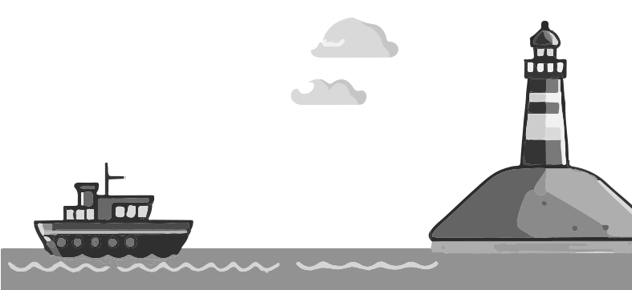
Pythagoras’ theorem in context
2) A lighthouse is 50 metres tall, and the light from it travels 130 metres to reach the boat.
The captain of the boat confidently declares:
“we are 120 metres away from the shore”.
Explain why the captain might be wrong.
You may reference assumptions made by the captain that are incorrect.
130 m
50 m
3) A window cleaner needs to reach a window that is 412 cm above ground. This is safe to do if the horizontal distance from the wall to the foot of the ladder is a quarter of the height the ladder needs to reach.
a) Model this situation on this right-angled triangle, labelling any known lengths and which side of the triangle is modelling the ladder.
b) To what length should the window cleaner set their ladder?
c) What assumptions are you making about this context?

Slide 4
Pythagoras’ theorem in context
4) A phone mast that is 15 m in height is supported by a 24 m long cable that is tied to the ground with a hook.
Two lights are attached: one at the top of the phone mast, and the other at the hook, to reduce the risk of people walking into it at night time.
In order for the lights to work, a battery generator is attached to the base of the phone mast, and needs to be connected to both lights by an electrical wire.
a) Is a 35 metre long reel of electrical wire enough to connect the battery to both lights?
b) What assumptions have you made about this context in part a)?
Mathematics in Education and Industry.

